Slide 1



CSE299.3
FALL 2026/NSU
Group 02
SIDEQUEST
What we learned • Why we chose the tools • What we built • What comes next
Project Proposal
Faculty Advisor
Dr.Mohammad Shifat-E-Rabbi
Group 02
ZARIFA RAHMAN
TAZREAN TASNEEM
TAHMIDATUL AYESHA ASHA
SOUMIK SIKDER
TANZIM AHAMAD

Slide 2



WHY WE CHOSE FLUTTER & DART — AND WHAT WE LEARNED
FLUTTER
• ONE CODEBASE CAN SUPPORT ANDROID AND IOS.
• READY-MADE, CUSTOMIZABLE WIDGETS HELP BUILD CONSISTENT SCREENS.
• HOT RELOAD HELPS US SEE UI CHANGES QUICKLY.
DART
• IT IS FLUTTER’S MAIN PROGRAMMING LANGUAGE.
• IT SUPPORTS THE LOGIC BEHIND FORMS, NAVIGATION, AND INTERACTIONS.
Group 02
ZARIFA RAHMAN
TAZREAN TASNEEM
TAHMIDATUL AYESHA ASHA
SOUMIK SIKDER
TANZIM AHAMAD

Slide 3
WHY WE CHOSE FLUTTER & DART — AND WHAT WE LEARNED
WHAT WE LEARNED
• FLUTTER WIDGETS BUILD THE VISIBLE INTERFACE.
• DART VARIABLES, CLASSES, AND FUNCTIONS CONTROL BEHAVIOUR.
• SETSTATE() REFRESHES THE UI AFTER LOCAL STATE CHANGES.
• VALIDATORS CHECK FORM INPUT BEFORE NAVIGATION.
• NAVIGATOR CONNECTS SCREENS SUCH AS SPLASH → LOGIN → HOME.
• CHROME LETS US TEST THE PROTOTYPE BEFORE MOBILE SETUP.
Group 02
ZARIFA RAHMAN
TAZREAN TASNEEM
TAHMIDATUL AYESHA ASHA
SOUMIK SIKDER
TANZIM AHAMAD

Slide 4
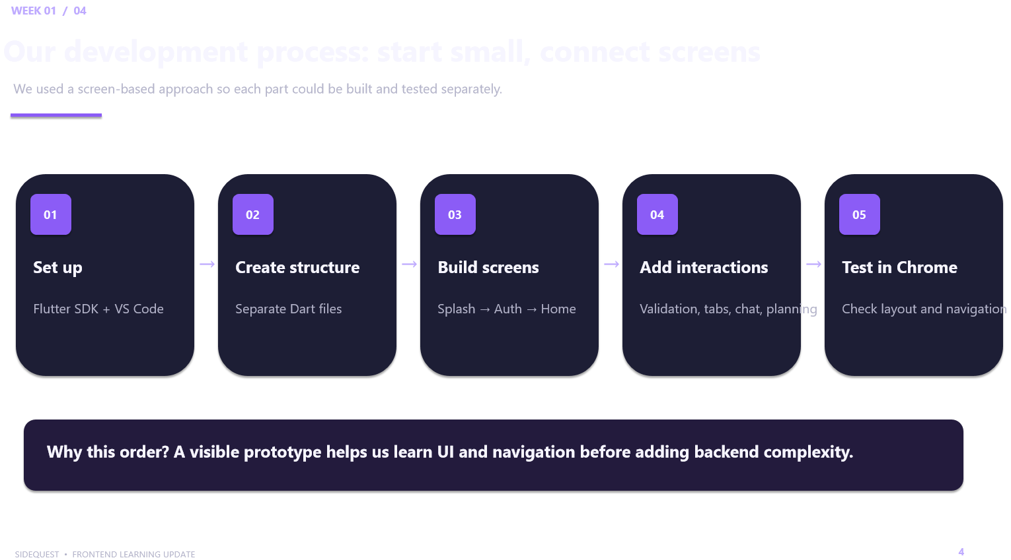

OUR DEVELOPMENT PROCESS: START SMALL, CONNECT SCREENS
Group 02
ZARIFA RAHMAN
TAZREAN TASNEEM
TAHMIDATUL AYESHA ASHA
SOUMIK SIKDER
TANZIM AHAMAD

Slide 5
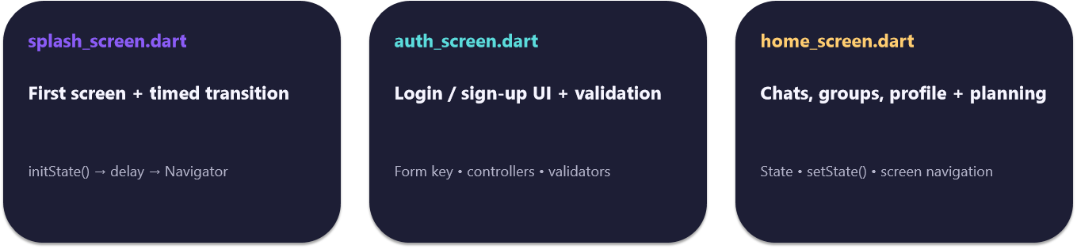

WHAT WE LEARNED FROM THE DART FILES
Group 02
ZARIFA RAHMAN
TAZREAN TASNEEM
TAHMIDATUL AYESHA ASHA
SOUMIK SIKDER
TANZIM AHAMAD

Slide 6
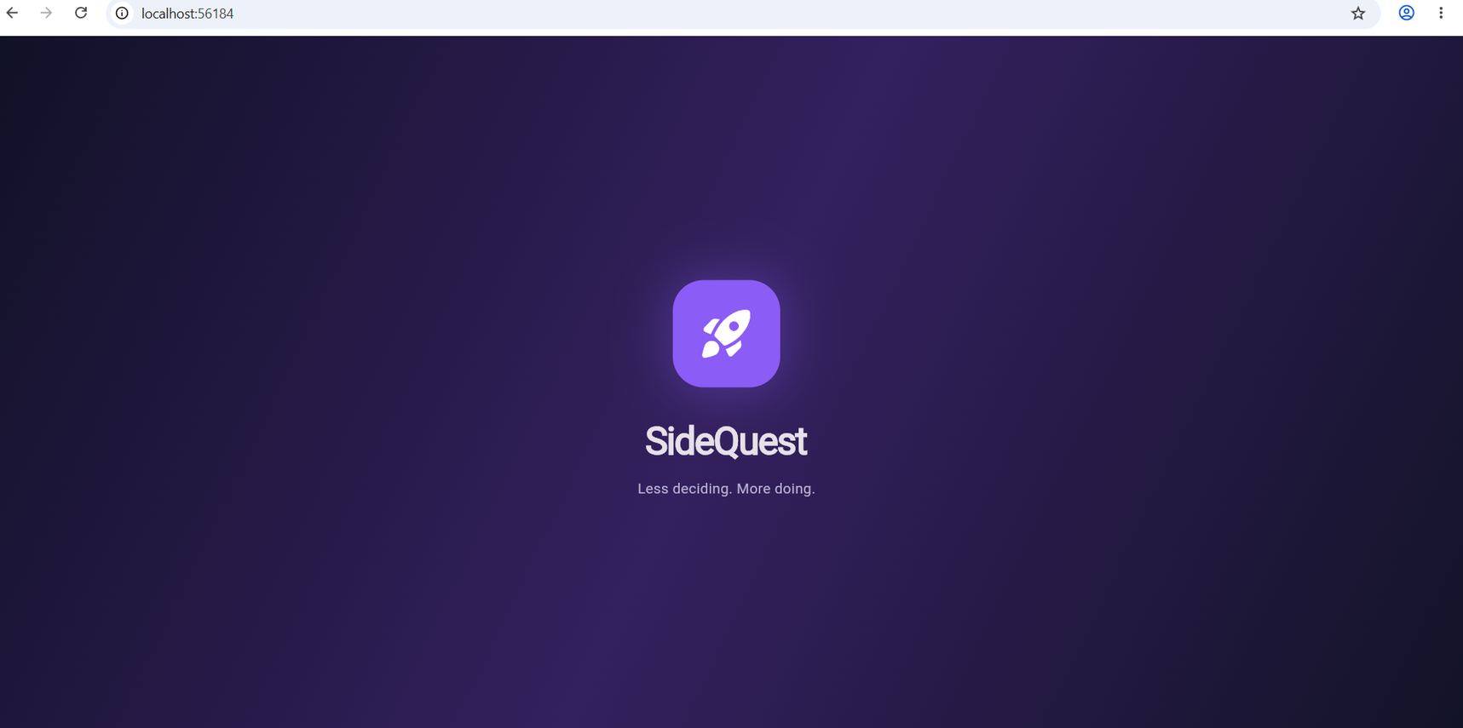
PROTOTYPE EVIDENCE: WHAT IS ALREADY IMPLEMENTED
Group 02
ZARIFA RAHMAN
TAZREAN TASNEEM
TAHMIDATUL AYESHA ASHA
SOUMIK SIKDER
TANZIM AHAMAD

Slide 7
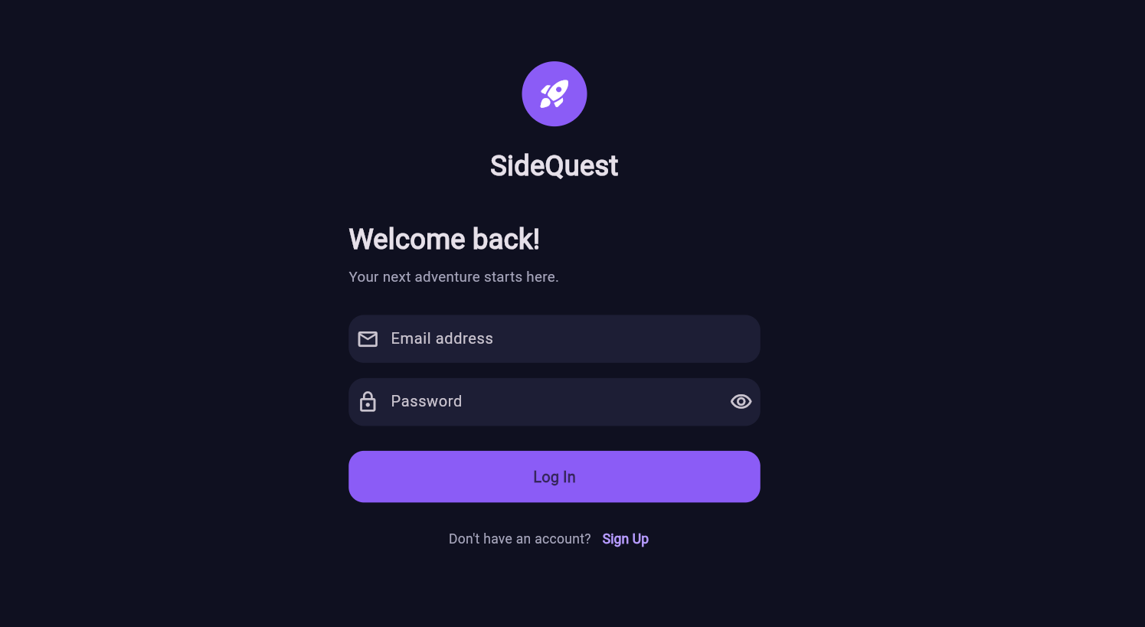
PROTOTYPE EVIDENCE: WHAT IS ALREADY IMPLEMENTED
Group 02
ZARIFA RAHMAN
TAZREAN TASNEEM
TAHMIDATUL AYESHA ASHA
SOUMIK SIKDER
TANZIM AHAMAD

Slide 8
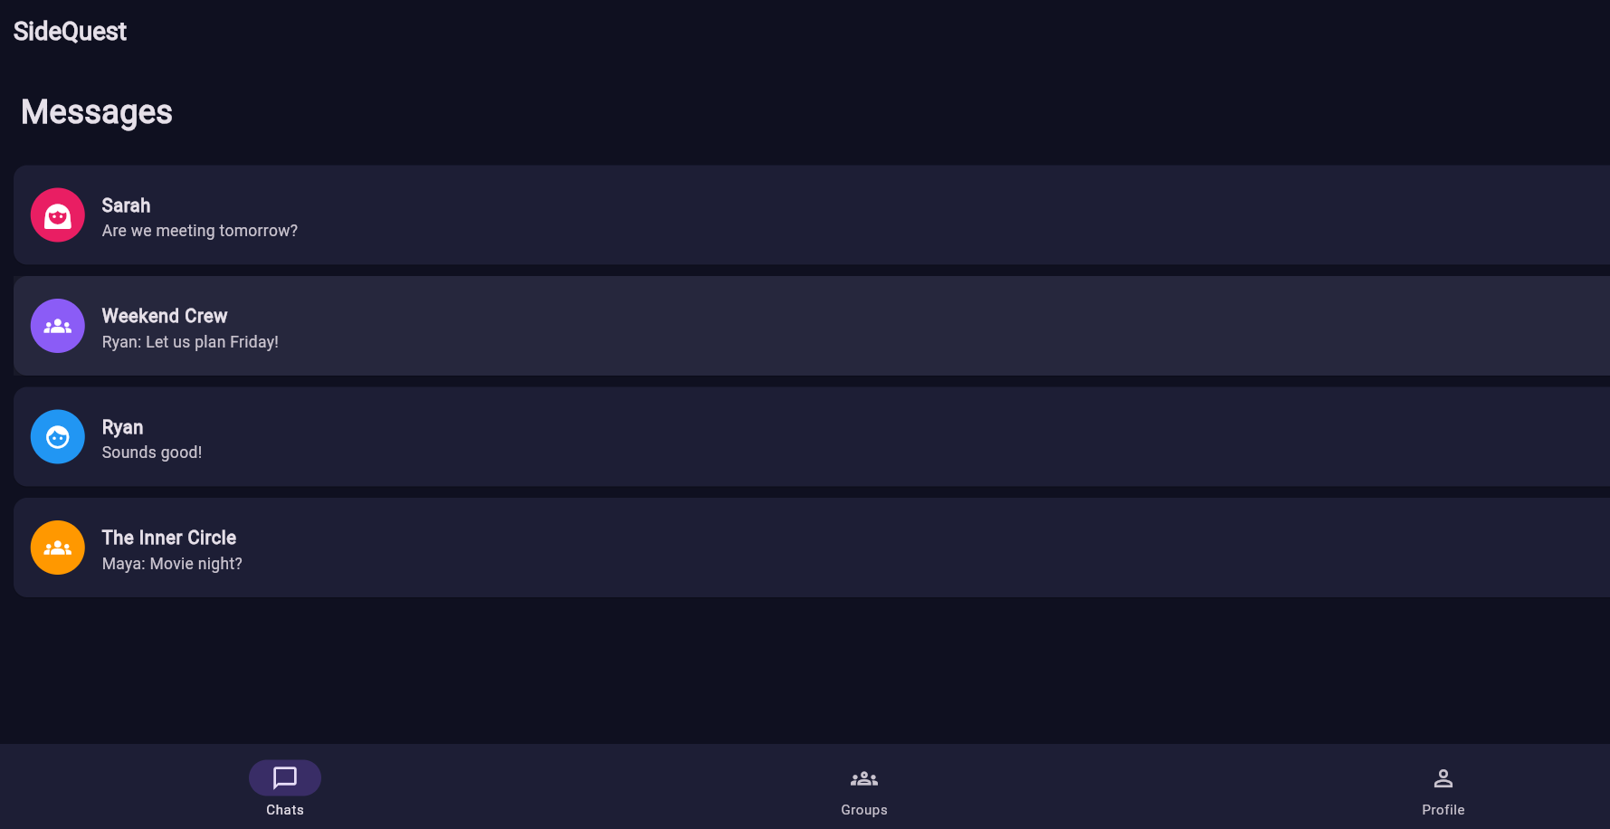
PROTOTYPE EVIDENCE: WHAT IS ALREADY IMPLEMENTED
Group 02
ZARIFA RAHMAN
TAZREAN TASNEEM
TAHMIDATUL AYESHA ASHA
SOUMIK SIKDER
TANZIM AHAMAD

Slide 9
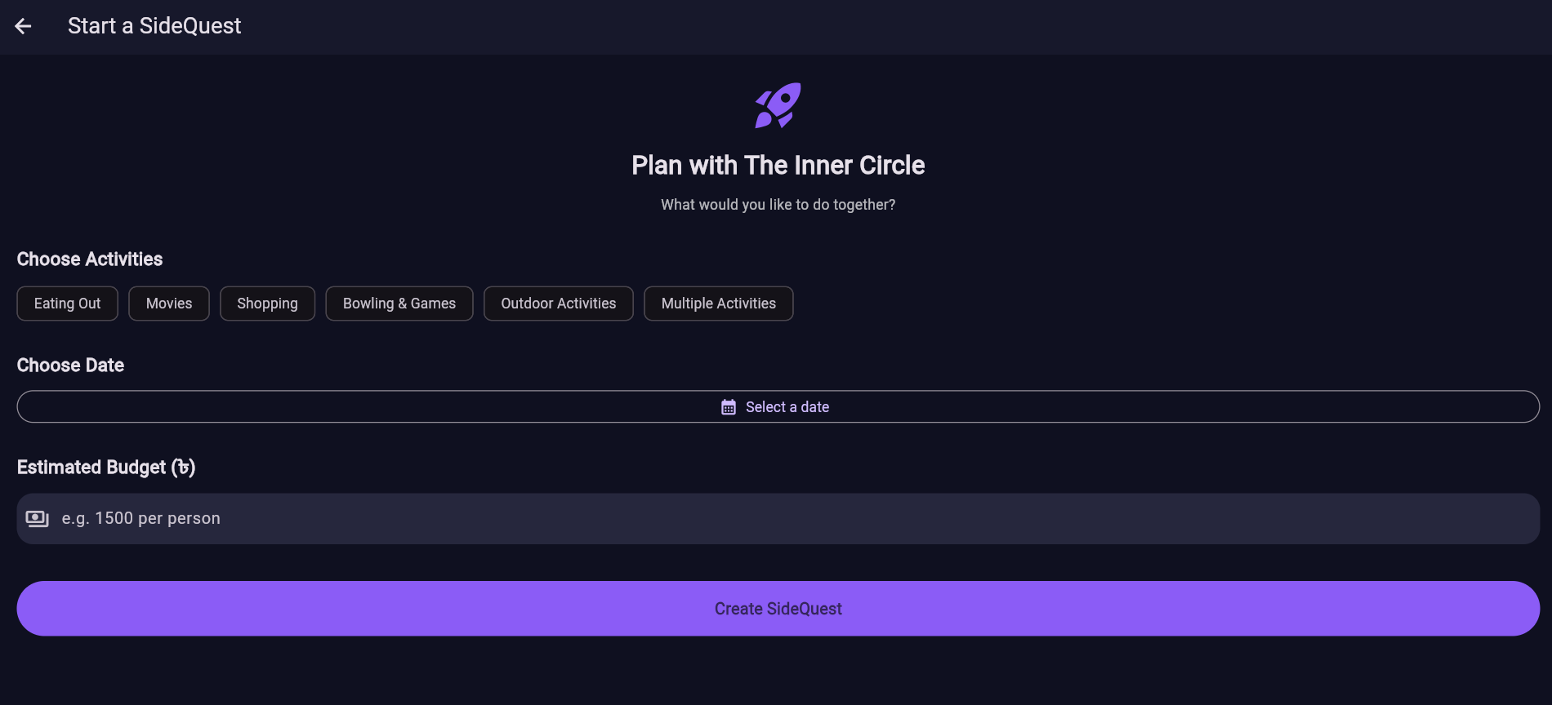
PROTOTYPE EVIDENCE: WHAT IS ALREADY IMPLEMENTED
Group 02
ZARIFA RAHMAN
TAZREAN TASNEEM
TAHMIDATUL AYESHA ASHA
SOUMIK SIKDER
TANZIM AHAMAD

Slide 10
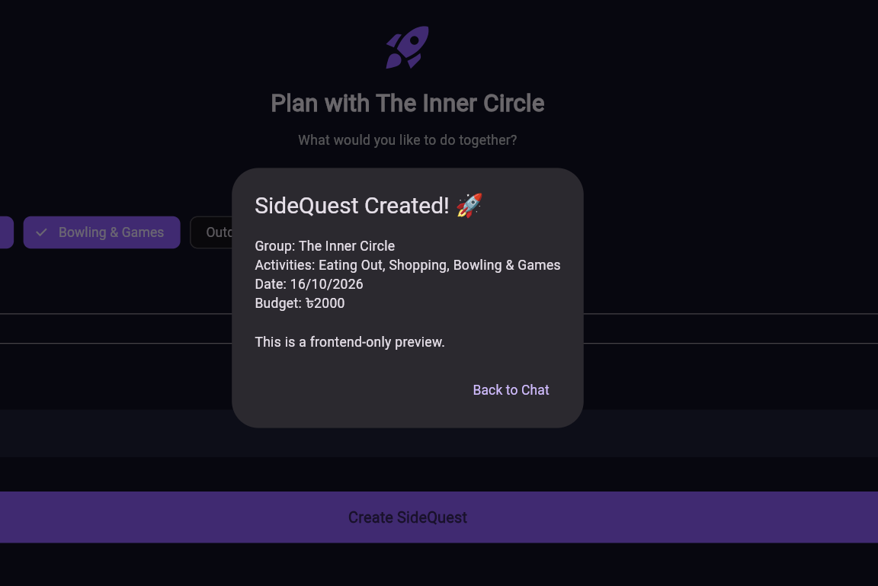
PROTOTYPE EVIDENCE: WHAT IS ALREADY IMPLEMENTED
Group 02
ZARIFA RAHMAN
TAZREAN TASNEEM
TAHMIDATUL AYESHA ASHA
SOUMIK SIKDER
TANZIM AHAMAD

Slide 11
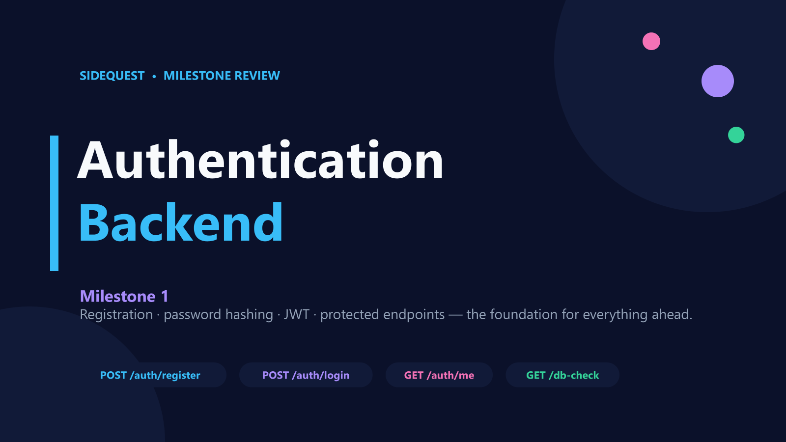
Group 02
ZARIFA RAHMAN
TAZREAN TASNEEM
TAHMIDATUL AYESHA ASHA
SOUMIK SIKDER
TANZIM AHAMAD

Slide 12
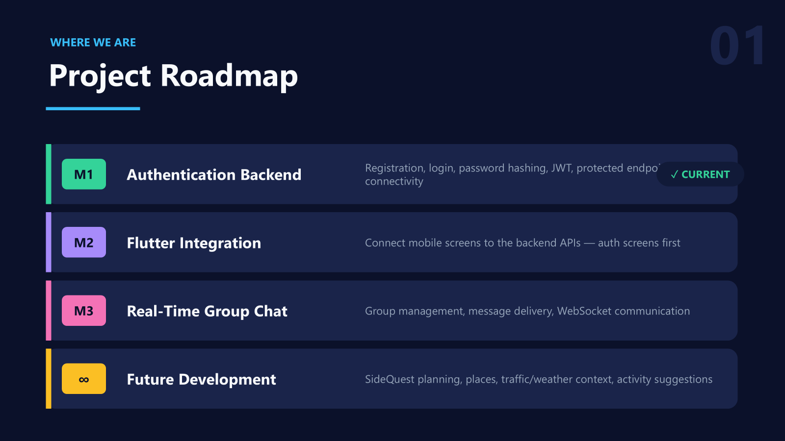
Group 02
ZARIFA RAHMAN
TAZREAN TASNEEM
TAHMIDATUL AYESHA ASHA
SOUMIK SIKDER
TANZIM AHAMAD

Slide 13
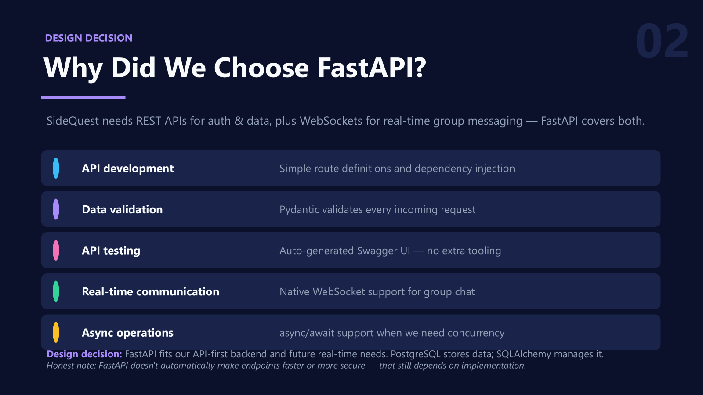
Group 02
ZARIFA RAHMAN
TAZREAN TASNEEM
TAHMIDATUL AYESHA ASHA
SOUMIK SIKDER
TANZIM AHAMAD

Slide 14
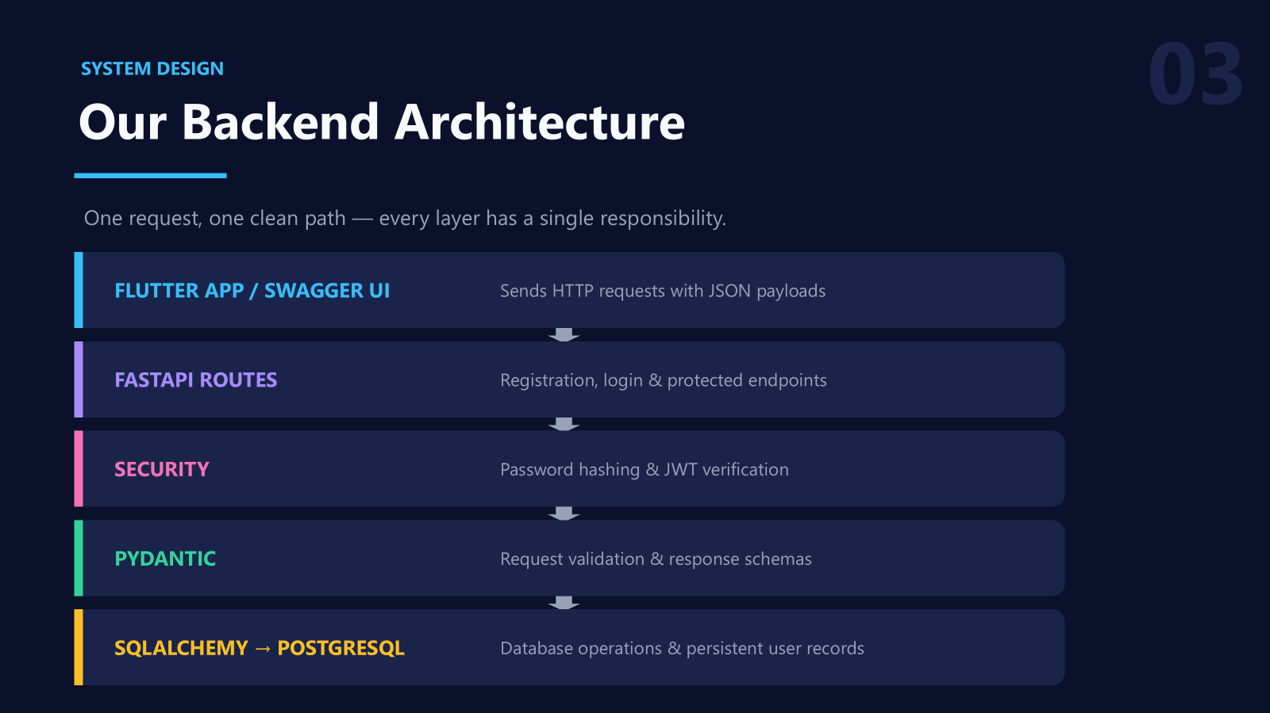
Group 02
ZARIFA RAHMAN
TAZREAN TASNEEM
TAHMIDATUL AYESHA ASHA
SOUMIK SIKDER
TANZIM AHAMAD

Slide 15
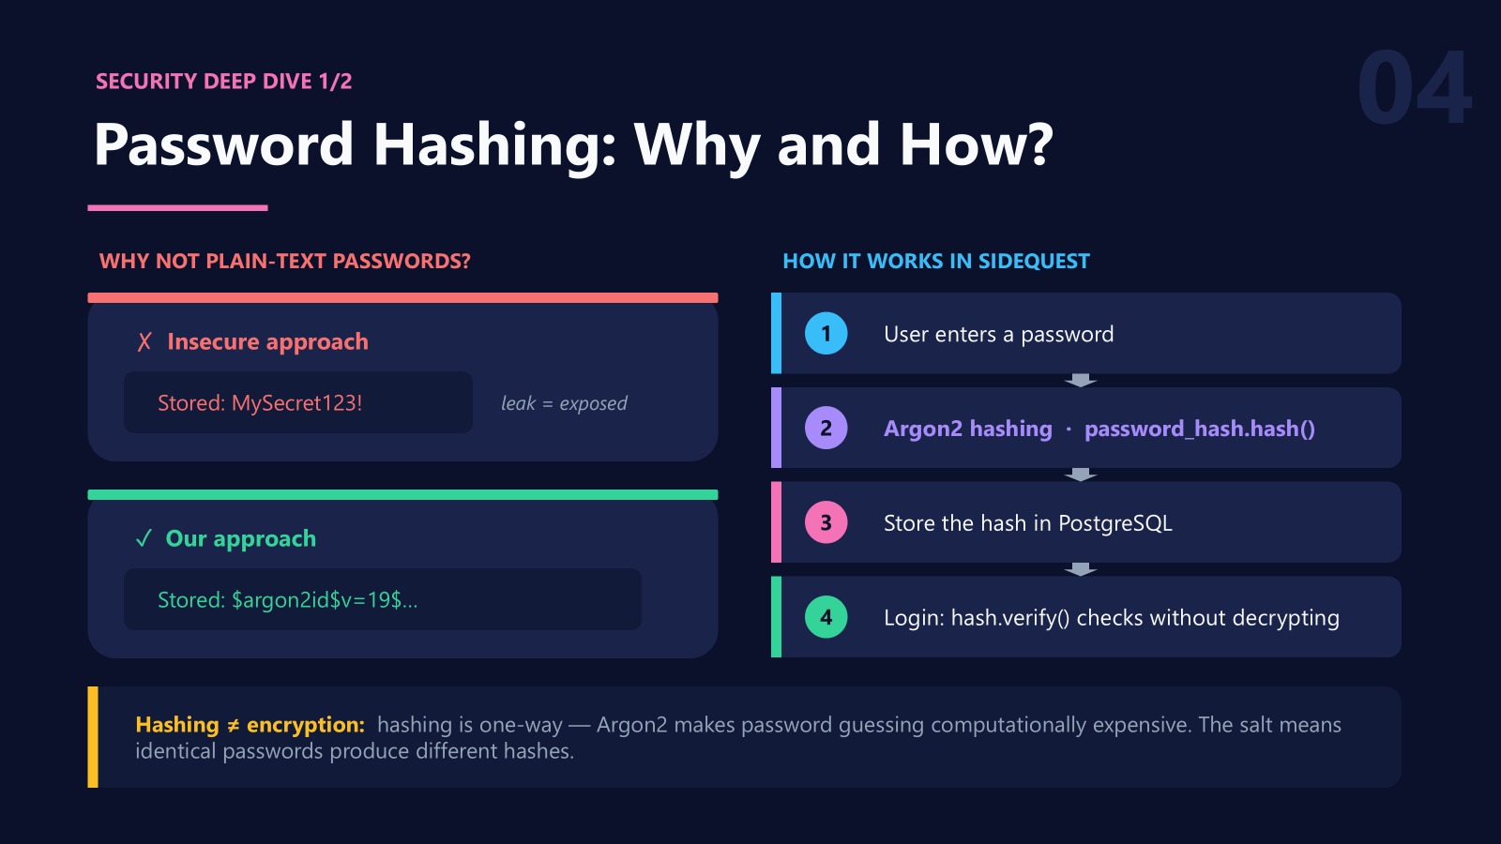
Group 02
ZARIFA RAHMAN
TAZREAN TASNEEM
TAHMIDATUL AYESHA ASHA
SOUMIK SIKDER
TANZIM AHAMAD

Slide 16
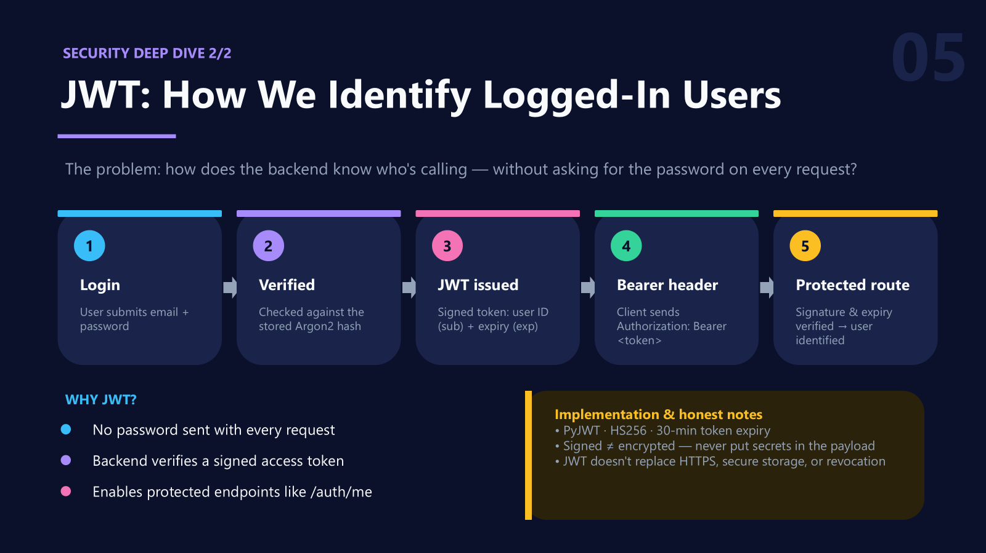
Group 02
ZARIFA RAHMAN
TAZREAN TASNEEM
TAHMIDATUL AYESHA ASHA
SOUMIK SIKDER
TANZIM AHAMAD

Slide 17
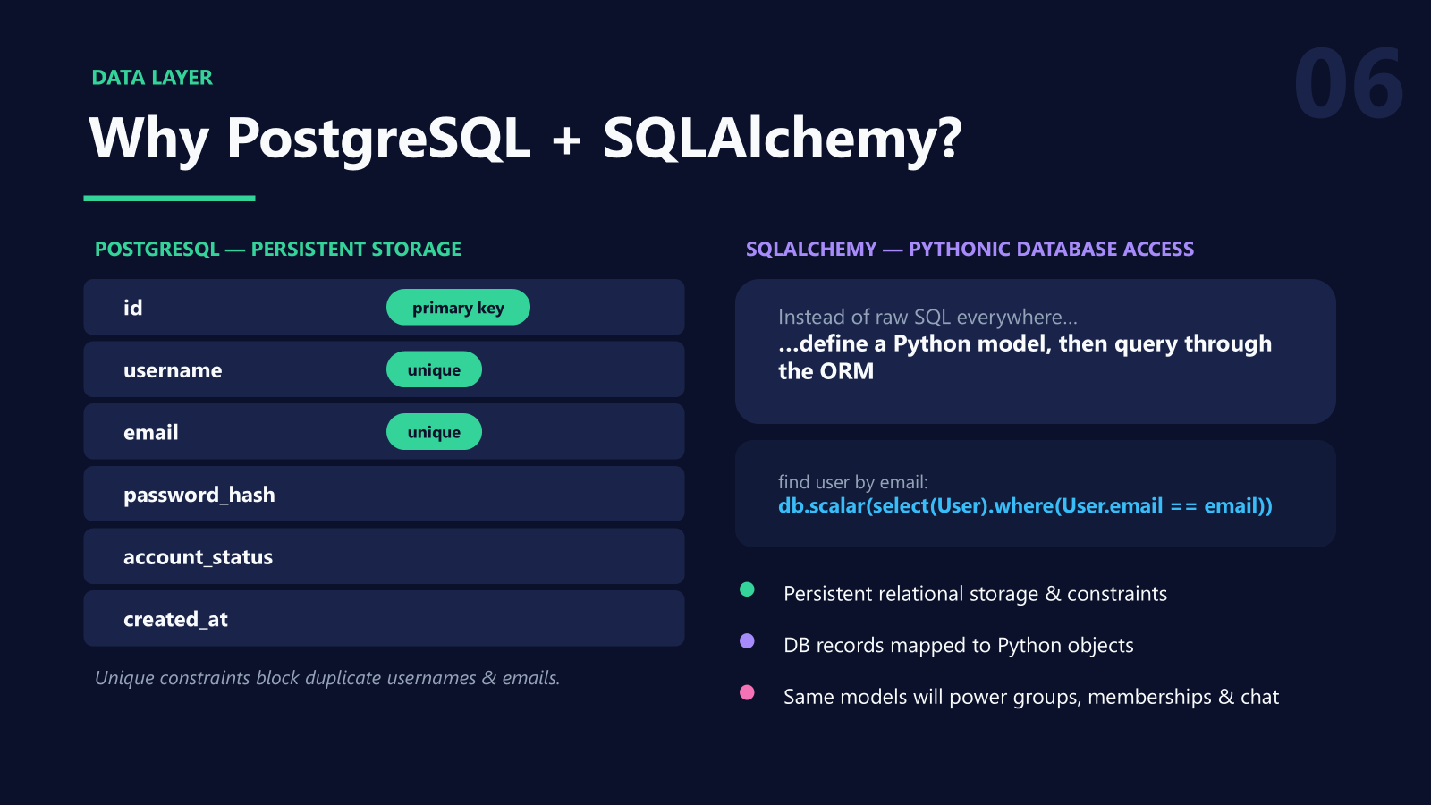
Group 02
ZARIFA RAHMAN
TAZREAN TASNEEM
TAHMIDATUL AYESHA ASHA
SOUMIK SIKDER
TANZIM AHAMAD

Slide 18
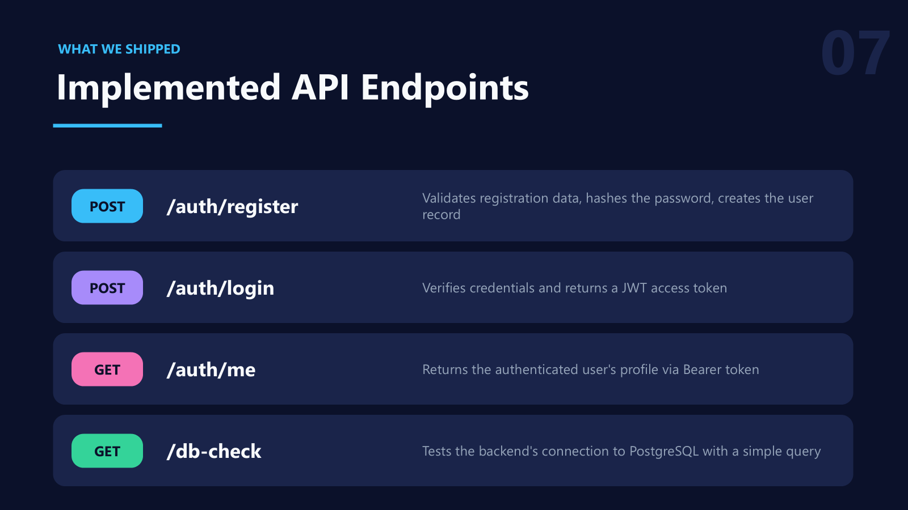
Group 02
ZARIFA RAHMAN
TAZREAN TASNEEM
TAHMIDATUL AYESHA ASHA
SOUMIK SIKDER
TANZIM AHAMAD

Slide 19
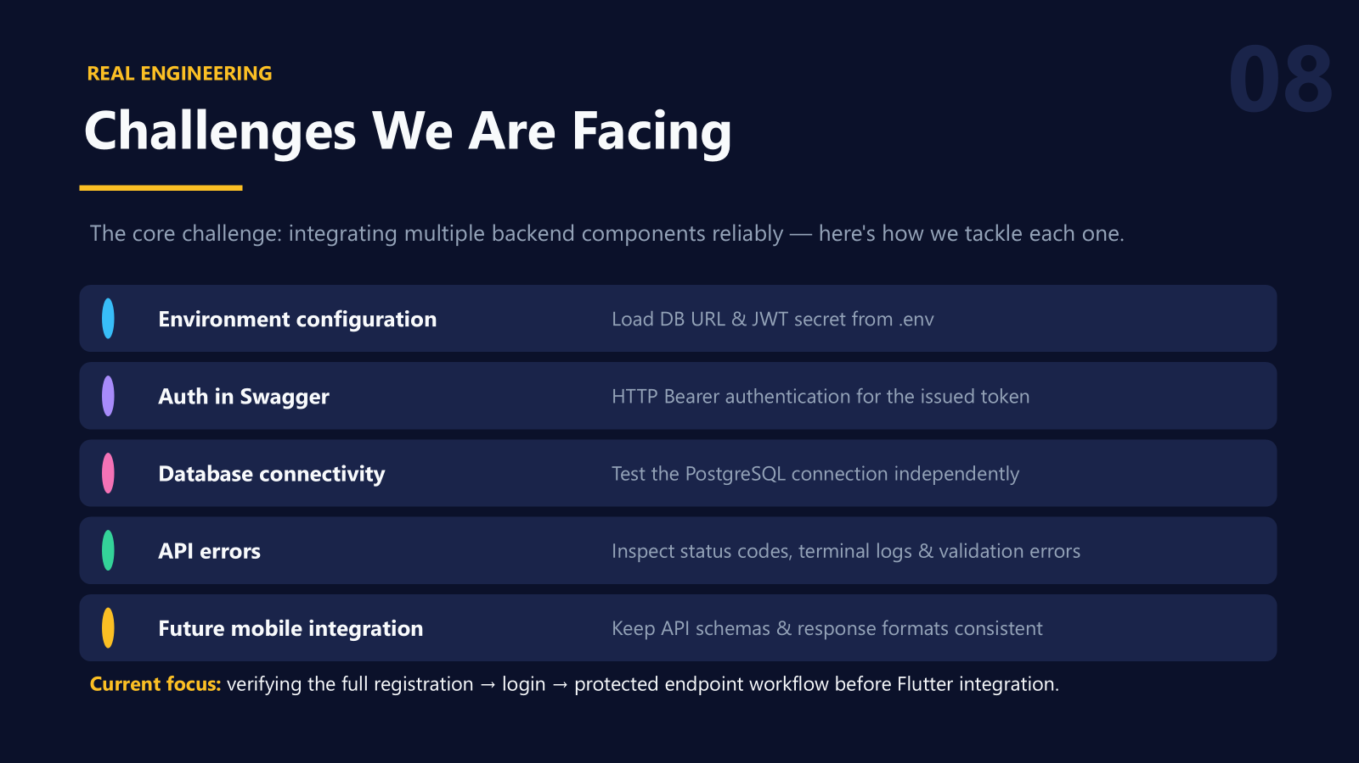
Group 02
ZARIFA RAHMAN
TAZREAN TASNEEM
TAHMIDATUL AYESHA ASHA
SOUMIK SIKDER
TANZIM AHAMAD

Slide 20
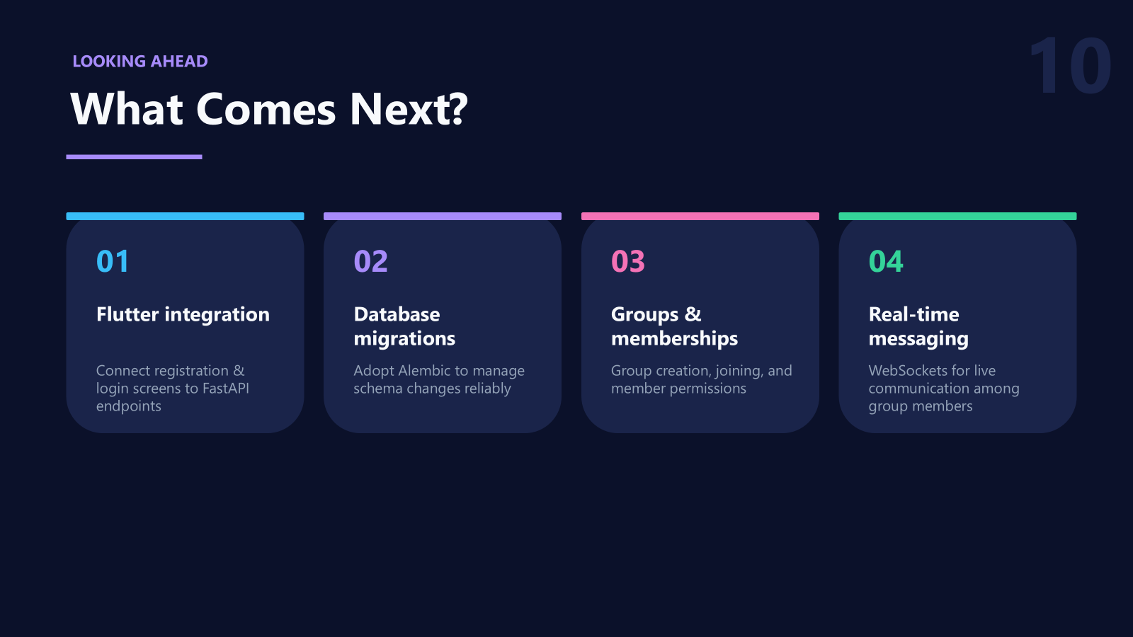
Group 02
ZARIFA RAHMAN
TAZREAN TASNEEM
TAHMIDATUL AYESHA ASHA
SOUMIK SIKDER
TANZIM AHAMAD

Slide 21
THANK YOU!
Group 02
ZARIFA RAHMAN
TAZREAN TASNEEM
TAHMIDATUL AYESHA ASHA
SOUMIK SIKDER
TANZIM AHAMAD

